Slide 1

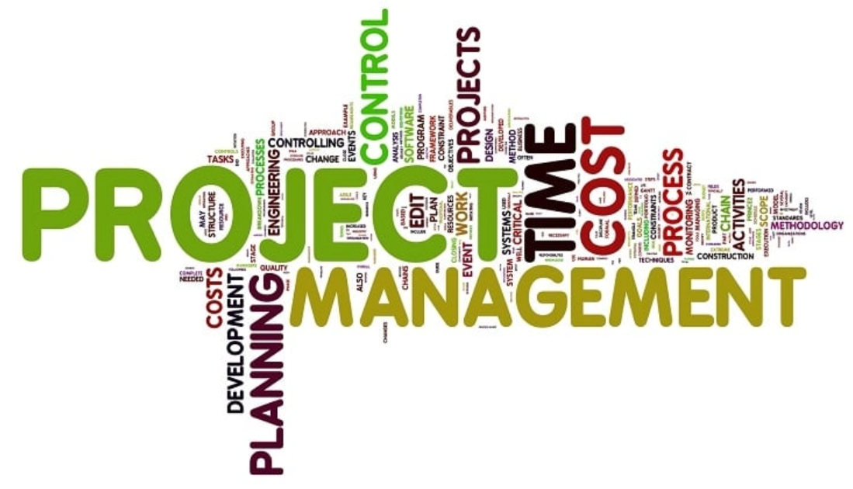
Project Management for computer engineers
(25CPE4602)
Lecture 1: Introduction to Project Management
Dr. Zahraa Ismail

Slide 2
Course staff & timing
Instructor | Dr. Zahraa Ismail
TAs | Eng. Salma Samy and Eng. Malak
Lecture Schedule | Tuesday from 12 pM – 2 PM (ECE
Lecture location | A-LH-3
Email | Zahraa.Ismail@bue.edu.eg

Slide 3
Course Assessment
Assessment | Weight
Project | 20%
In-class Exam | 20%
Final Exam | 60%

Slide 4
Text book
Clifford F. Gray and Erik W. Larson,
“Project Edition”,
Management: The Managerial Process, 7th
McGraw-Hill, ISBN: 978-1-259-66609-4, 2018.
John M. Nicholas, Project Management for Engineering, Business and Technology 6th Edition, Routledge; 6th edition (August 3, 2020), ISBN: 978-0367277345

Slide 5
References
Chris Croft, Project Management QuickStart Guide: The Simplified Beginner’s Guide to Precise Planning, Strategic Resource Management, and Delivering World Class Results (QuickStart Guides™ - Business) Paperback – May 29, 2022, ClydeBank Media LLC (May 29, 2022), ISBN:
978-1636100586
Neil G. Siegel, Engineering Project Management 1st Edition, Wiley; 1st edition (February 18, 2020), ISBN: 978-1119525769
Erik W. Larson and Clifford F. Gray, ISE Project Management: The Managerial Process (ISE HED IRWIN OPERATIONS/DEC SCIENCES) Paperback – International Edition, March 5, 2020, McGraw-Hill Education; 8th edition (March 5, 2020), ISBN: 978-1260570434

Slide 6
Course Objectives
The objectives of a project management course typically include:
Understanding Project Management Fundamentals
Project Planning
Resource Management
Risk Management
Time Management
Communication Skills
Quality Management
Use of Project Management Tools
Leadership and Team Dynamics
Evaluation and Closure
Notes:
Introduce and develop the skills and knowledge associated with delivering a successful engineering project (planning, scheduling and controlling time, cost and other resources of a project).
The objectives of a project management course typically include:
Understanding Project Management Fundamentals: Learn the key concepts, terminology, and processes involved in managing projects effectively.
Project Planning: Develop skills in creating project plans, including defining scope, objectives, and deliverables.
Resource Management: Learn how to allocate and manage resources (human, financial, and material) efficiently.
Risk Management: Identify potential risks and develop strategies to mitigate them throughout the project lifecycle.
Time Management: Master techniques for scheduling tasks and managing timelines to ensure project completion on time.
Communication Skills: Enhance communication and interpersonal skills to effectively lead teams and engage stakeholders.
Quality Management: Understand how to maintain quality standards and ensure project deliverables meet expectations.
Use of Project Management Tools: Familiarize with software and tools that aid in project planning, monitoring, and reporting.
Leadership and Team Dynamics: Learn about team building, conflict resolution, and leading diverse teams.
Evaluation and Closure: Understand the processes for project evaluation, reporting outcomes, and closing projects effectively.
These objectives aim to equip learners w

Slide 7
Introduction
to
Project Mnagement

Slide 8
Contents
Definition of a Project, project management, and PMI?
Characteristics of project
Current Drivers of Project Management
Project Management Today: A Socio-Technical Approach
Examples of Projects

Slide 9
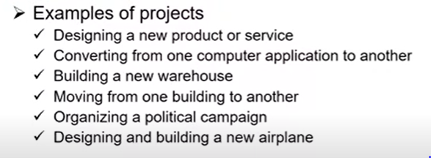
Definitions (1/2)
Project: Temporary activities (efforts) performed to create a unique product, service, or result.
Examples:
  Hospitals Respond to New Healthcare treatment
  Apple’s New iPhone Hits the Market
  Constructing a building or facility
  Designing a new transportation vehicle
  Organizing a meeting
Project Management: A powerful set of tools that improves people’s ability to plan, implement, and manage projects.
Notes:
A project is a combination of interrelated activities to achieve a specific objective within a schedule, budget, and quality. It involves the coordination of group activity, wherein the manager plans, organizes, staffs directs, and controls to achieve an objective, with constraints on time, cost, and performance of the end product. Project management is the combination of project and management.
Planning is the strong key to making the project more effective and utilization of resources to achieve the goal. In this, we will focus on characteristics of the project like how objectives are important for achieving the goal, the total time duration of the project, calculated risk, and uncertainty of the project, the total estimated cost of the project, etc. are essential characteristics of the project and will discuss some other characteristics of the project like team spirit, require funds, directions, uniqueness, flexibility, and subcontracting, etc. Let's discuss it one by one.

Slide 10
Definitions (2/2)
PMI (Project Management Institute): It is an institute founded in 1969 as an international society for project managers. It provides certificates such as PMP (Project Management Professional) for project team members and CAPM (Certified Associate in Project Management) for entry level project managers.
Notes:
It is an organization that was established in 1969 as a global project management association. It offers certifications like CAPM (Certified Associate in Project Management) for entry-level project managers and PMP (Project Management Professional) for project team members.

Slide 11
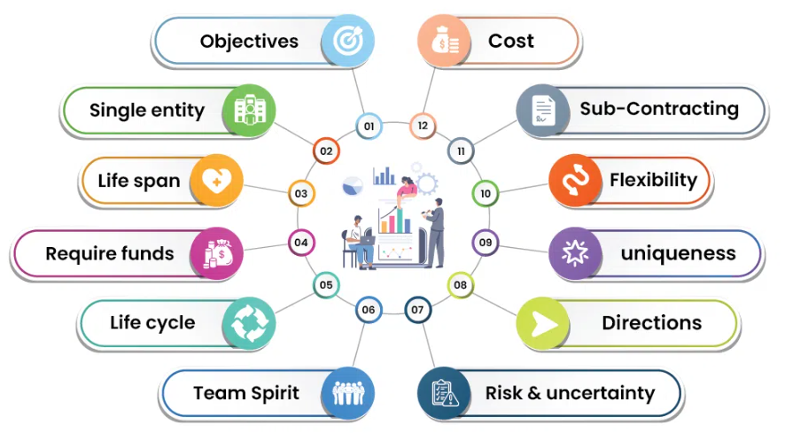
Characteristics of project
Notes:
Has an established objective.
Has a defined lifespan with a beginning and an end.
Involves several departments and professionals.
Involves doinq something new (not done before).
Has specific time, cost, and performance requirements.
A clear and defined objective.
A defined life span with a beginning and an end.
Usually, the involvement of several departments and professionals.
Typically, doing something that has never been done before.
Specific time, cost, and performance requirements.
Objectives
Every project is started with some objective or goal viz. time, budget, quality, and quantity, when objectives are fulfilled project cause exists. You can initially define the objectives of the project and what actually need to achieve. Objectives are the key characteristics of the project where you will see the progress of the project and time to time analysis will show you the result of how much you have achieved.
Single entity
A project is one whole thing. This means that in a project, although different people contribute still is recognized as a single entity. The teams are often specifically assembled for a single project.
Life Span
No project can be ceaseless and indefinite. It must have one and beyond which it cannot proceed. Every project is invariably time-bound. At the time of planning, you will see the time phase of the project where the team can work independently on the project modules. Let's consider an example project that is divided into three modules let's say A, B, and C. If the total time span of a project is 5 months then you can set the time span for modules independently like A can complete in 2 months and also B can complete in 2 months and C can complete in 1 month as per requirement.
Require funds
Every project needs funds to reach the endpoint. Without adequate funds, no project can be successfully implemented. Cost estimation is one of the essential factors for any organization. So, calculating in advance the required funds for the project will be very impactful.
Life Cycle
Each project has a life cycle with different stages like start, growth, maturity, and decay. A project has to pass through different stages to get itself completed. Let's consider an example where the project is related to software development then you can say SDLC (Software Development lifecycle) will be the life cycle of the project where you will see many stages like planning, defining, designing, building, testing, and deployment, etc.
Team Spirit
Team spirit is required to get the project completed because the project constitutes different members having different characteristics and from various disciplines. But to achieve common goal harmony, missionary zeal, team spirit is necessary.
Risk and Uncertainty
The project is generally based on forecasting. So risk and uncertainty are always associated with projects. There will be a high degree of risk in those project which are not properly defined. Only the degree of control over risk and uncertainty varies with the project being conceived based on information available.
for more Details Please refer the article : Risk Analysis in Project Management
Directions
Project is always performed according to the directions given by the customers with regard to time, quality and quantity, etc. The convenience of the supply sides of economics such as labor availability ore resources and managerial talent etc. are all secondary concerns, primary being the customer requirement.
Uniqueness
Each project is unique in itself, and it's having own features. No two projects are similar even if the type of organization is the same. The uniqueness of the project can measure by considering the many factors like objectives, features of the project, application of the project, etc.
Flexibility
Change and project are synonymous. A project sees many changes throughout its life span. These changes can make projects more dynamic and flexible.
Sub-Contracting
Subcontracting is a subset of every project and without which no project can be completed unless it is a proprietary firm or tiny in nature. The more complexity of a project the more will be the extent of contracting. Every project needs the help of an outsider consultant, engineer, or expert in that field.
Cost
If the quality of the project is to be changed there could be an impact on the cost of the project. The cost could increase if more resources are required to complete the project quicker.

Slide 12
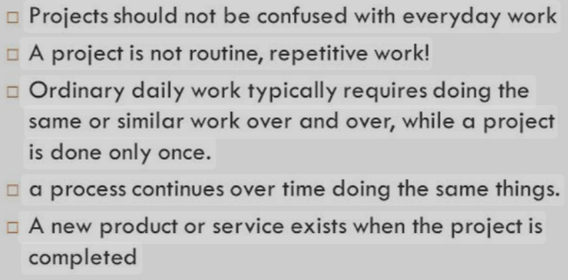
What a Project Is Not ?
A project is not routine, repetitive work! Ordinary daily work typically requires doing the same or similar work over and over

Slide 13
Examples
Attaching tags on a manufactured product
Daily entering sales receipts into the accounting ledger
Developing a new IPhone model
Routine manufacture of an Apple iPod
Practicing scales on the piano
Writing a new piano piece
Going to college every day.
Designing a new Tesla electric car
Copying text
Developing a supply-chain information system
Routine work Routine work
Project Routine work
Routine work Project Routine work Project Routine work Project

Slide 14
Program versus Project
Definition of program :
A program is a group of related projects designed to accomplish a common goal over an extended period of time.
Each project within a program has a project manager.
The major differences lie in scale and time span
Program management is the process of managing a group of ongoing, interdependent, related projects in a coordinated way to achieve strategic objectives for the organization or the company.
13
Notes:
A project is a temporary endeavor with a specific goal and defined start and end dates, while a program is a group of related projects managed together to achieve a broader strategic objective. Projects focus on delivering outputs, while programs focus on realizing benefits.
Here's a more detailed breakdown:
Project:
Temporary: Has a defined beginning and end.
Specific Goal: Aims to achieve a particular outcome or deliverable.
Defined Scope: The work required is clearly outlined and limited.
Fixed Timeline: Has a specific timeframe for completion.
Example: Developing a new website for a company.
Program:
Ongoing: May be long-term and continue through organizational changes.
Strategic Objective: Focuses on achieving a larger strategic goal for the organization.
Collection of Projects: Involves managing multiple related projects.
Broader Scope: The scope is more fluid and can evolve based on business needs.
Example: A program to improve customer service across multiple departments, involving projects like training, process improvements, and technology upgrades.
Key Differences:
Scope:
Projects have a defined scope, while programs have a broader, more flexible scope.
Duration:
Projects are temporary, while programs can be ongoing or long-term.
Focus:
Projects focus on delivering outputs, while programs focus on achieving strategic benefits.
Management:
Project managers focus on individual projects, while program managers oversee multiple related projects.

Slide 15
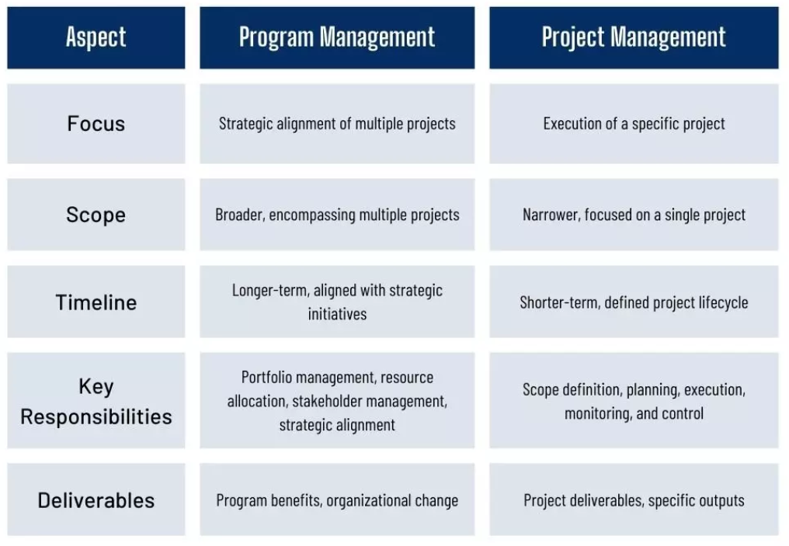
What is a Proqram versus Project?
Notes:
Scope:
Projects have a defined scope, while programs have a broader, more flexible scope.
Duration:
Projects are temporary, while programs can be ongoing or long-term.
Focus:
Projects focus on delivering outputs, while programs focus on achieving strategic benefits.
Management:
Project managers focus on individual projects, while program managers oversee multiple related projects.

Slide 16
What is a Proqram versus Project?
Proiect: completion of all required stages in a certain project.
Proqram: completion of all required projects in a certain program.

Slide 17
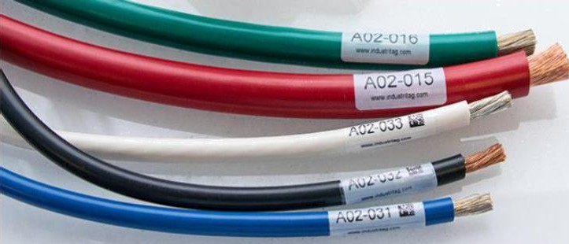
Comparison of Routine Work with Projects
Takinq class notes.
Daily enterinq sales receipts into account book (ledger).
Resgondinq to a supply-chain request.
Writinq a research paper.
Settinq up a digital display of sales for a professional accounting meeting.
Developinq a supply-chain information system.
Wire-tag (special tag) project for a large store.
Attachinq tags on a manufactured product.
*** Supply-chain: sequence of processes involved in production and distribution of goods.

Slide 18
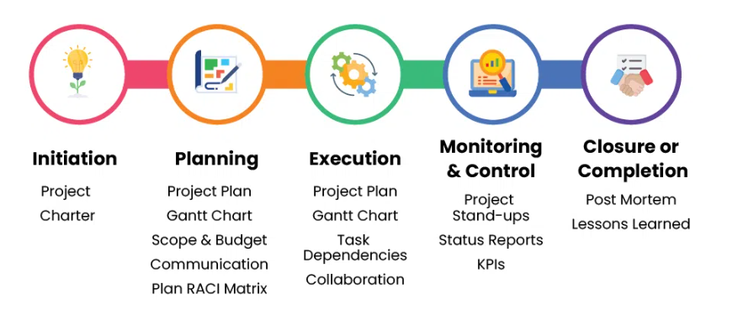
Project Life Cycle
Notes:
1. Project Initiation
Using a number of project management documents, the project manager must demonstrate at this first stage that the project is feasible and valuable. The following are the principal ones:
Business case: A business case explains why the project is necessary and outlines its goals and expected return on investment.
Feasibility study: A feasibility study establishes the project's ability to be completed on schedule and within budget.
Project charter: A project charter outlines the goals and objectives of the project.
The project manager is required to form a project team and establish a project management office upon approval of the project. Project goals and scope are set at the kickoff meeting, which concludes the project beginning phase.
2. Project Planning
The production of a project plan, a detailed project document outlining the project's execution strategy, is the aim of the project planning phase. This is a brief synopsis of a project plan's key components.
Project schedule: This outlines a timetable for work completion and resource distribution.
Project budget: The total of all projected project expenses is the project budget.
Scope management plan: The scope management plan outlines the tracking procedures for the scope of your project as it progresses.
Risk management plan: The project's potential risks are described in the risk management plan, along with mitigation techniques.
Resource management plan: The resource management strategy outlines the acquisition, distribution, and management of your resources during the course of the project.
Stakeholder management plan: All project stakeholders are listed in the stakeholder management strategy, along with management rules.
Gantt chart software, which offers a visual depiction of the complete project timeline and project scope, is frequently used by project managers to set up their project plans. Certain Gantt charts can recognise critical path activities on their own.
3. Project Execution
Project execution, or carrying out the plan in order to accomplish the goals and objectives of the project, is the third stage of project management. As a project moves closer to the monitoring and control phase, project managers must supervise the project management knowledge areas during the project execution phase. In order to keep the team working, the project manager will reallocate resources or modify the time and scope as necessary. They will also recognise and reduce risks, address issues, and apply any modifications.
4. Project Monitoring and Control
Project monitoring and control, the fourth phase of project management, happens while the project is being executed. In order to make sure the project team stays on track and within budget, it entails keeping an eye on how the project execution activities are going. Quality assurance is ensured through the application of quality control techniques. Another essential component of this project management phase is reporting. Project managers can use it to monitor progress in the first place, and stakeholders can receive updates during presentations by using the data it provides. Numerous project management reports are available, including those on project status, timesheets, workload, allocation, and expenses.
5. Project Closure
Project closing, the fifth stage of project management, involves presenting the stakeholders with the completed deliverables. Resources are released, paperwork is finished, and everything is signed off on after approval.

Slide 19
Project Life Cycle (1/2)
Defining stage: Specifications are defined; project objectives are established; teams are formed; major responsibilities are assigned.
Planning stage: The level of effort increases, and plans are developed to determine what the project will entail, when it will be scheduled, whom it will benefit, what quality level should be maintained, and what the budget will be.
14
Notes:
A program, like a project, follows a distinct lifecycle. While the specific phases can vary depending on the organization and industry, the general structure includes:
1. Initiation
This phase involves defining goals, identifying stakeholders, and securing necessary resources. This includes creating a comprehensive program charter outlining the overall objectives and scope of programs. For projects, the focus is on creating a project charter defining specific goals, scope, and feasibility.
2. Planning
The program manager develops a comprehensive program plan outlining phases, deliverables, and milestones, while the project manager creates detailed project plans. Both roles involve identifying constituent projects, establishing governance structures, and developing effective communication plans.
3. Execution
Program managers launch and manage individual projects within the program, while project managers focus on the day-to-day execution of their assigned projects. Both roles involve monitoring progress, identifying and mitigating risks, and managing stakeholder expectations.
4. Delivery
Program managers focus on realizing the expected benefits for the organization, while project managers ensure that individual projects deliver their intended outcomes. Both roles involve measuring performance against objectives and capturing lessons learned for future initiatives.
5. Closure
Program managers evaluate the program's effectiveness, transfer deliverables to operational teams, and document lessons learned. Project managers assess project performance, document insights, and obtain formal closure from stakeholders.

Slide 20
Project Life Cycle (2/2)
Executing stage: The physical product is produced (a bridge, a report, a software program). Time, cost, and specification measures are used for control. Is the project on schedule, on budget, and meeting specifications? What are the forecasts of each of these measures? What revisions/changes are necessary?
Closing stage: Closing includes (3) activities: delivering the project product to the customer, redeploying project resources, and post- project review. Delivery of the project might include customer training and transferring documents. Redeployment usually involves releasing project equipment/materials to other projects and finding new assignments for team members. Post-project reviews include not only assessing performance but also capturing lessons learned
15

Slide 21
Program vs Project Manager Skills
The roles of project and program managers require a unique set of skills tailored to their specific responsibilities and the scope of work they manage:
Technical proficiency
Leadership
Communication
Organizational skills
Problem-solving
Risk management
Change management
Strategic thinking
Financial management
Stakeholder management
Notes:
The roles of project and program managers require a unique set of skills tailored to their specific responsibilities and the scope of work they manage:
Technical proficiency: While technical proficiency can be beneficial for both project and program managers, it is especially valuable for project managers who work closely with development teams. A basic understanding of coding can help project managers communicate more effectively, estimate tasks more accurately, and review project deliverables.
Leadership: The project manager focuses on project teams, while the program manager influences multiple teams and sometimes cross-functional groups.
Communication: Both roles require clear and concise communication techniques to manage expectations, engage stakeholders, and ensure project success. However, program managers often interact with a broader audience.
Organizational skills: While project managers organize tasks, set realistic deadlines, and allocate resources within a single project, program managers manage the organization of various projects within the broader program context.
Problem-solving: The project manager often tackles specific, project-related issues, while the program manager addresses broader challenges that may impact numerous projects or the entire program.
Risk management: While both assess and mitigate risks, the program manager focuses on broader, program-level risks that could impact multiple projects.
Change management: While both adapt to changes and effectively manage stakeholder expectations, project managers usually handle changes within the scope of a single project, whereas program managers manage changes that affect the program and might impact organizational strategy.
Strategic thinking: Program managers must align program goals with overarching organizational objectives and strategic plans. This requires a deep understanding of the business context and the ability to anticipate future trends and challenges.
Financial management: This includes managing the program's funding, allocating resources across multiple projects, and ensuring financial efficiency. While project managers are responsible for ensuring that projects are financially viable and executed within budget constraints, program managers must balance competing demands and make strategic decisions to optimize resource utilization and achieve program objectives.
Stakeholder management: Crucial for both, but program managers often deal with higher stakeholder interactions, including senior management and primary investors.

Slide 22
Importance of project management (1/3)
Reasons:
Compression of the Product Life Cycle: Currently, in high-tech industries the product life cycle is averaging (6) months to (3) years. Time to market for new products with short life cycles has become increasingly important. A common rule of thumb in the world of high- tech product development is that a (6) month project delay can result in a 33% loss in product revenue share
Knowledge Explosion: The growth in new knowledge has increased the complexity of projects because projects encompass the latest advances. Product complexity has increased the need to integrate divergent technologies

Slide 23
Importance of project management (2/3)
Triple Bottom Line (Planet, People, Profit): The threat of global warming has brought sustainable business practices to the forefront. Businesses can no longer simply focus on maximizing profit to the detriment of the environment and society.
Increased Customer Focus: Increased competition has placed a premium on customer satisfaction. Customers no longer simply settle for generic products and services. They want customized products and services that cater to their specific needs

Slide 24
Importance of project management (3/3)
Small Projects Represent Big Problems: The velocity of change required to remain competitive lead to hundreds of projects are implemented concurrently along with the problems generated from them; which represents major challenge to senior management. Because the perception of the inefficiency impact is small, measuring inefficiency is usually nonexistent. Unfortunately, many small projects soon add up to large sums of money. Many customers and millions of dollars are lost each year on small projects in product and service organizations. Small projects can represent hidden costs not measured in the accounting system

Slide 25
Why is Project Management Important?
Project management is vital for several reasons. Firstly, it ensures that projects are completed efficiently, within budget, and on schedule. By employing systematic planning, execution, and monitoring, project managers can anticipate and mitigate potential risks, ensuring smooth progress throughout the project lifecycle. Here are some of the reasons why project management is important:
Efficiency
Risk Management
Communication and Collaboration
Resource Optimization
Decision Making
Quality Assurance
Adaptability
Strategic Alignment
Notes:
Project management is vital for several reasons. Firstly, it ensures that projects are completed efficiently, within budget, and on schedule. By employing systematic planning, execution, and monitoring, project managers can anticipate and mitigate potential risks, ensuring smooth progress throughout the project lifecycle. Here are some of the reasons why project management is important:
Efficiency: Ensures projects are completed on time, within budget, and with optimal resource utilization.
Risk Management: Identifies and mitigates potential risks, ensuring smooth progress throughout the project lifecycle.
Communication and Collaboration: Enhances teamwork and stakeholder engagement through clear objectives, roles, and responsibilities.
Resource Optimization: Maximizes efficiency by carefully allocating resources such as time, money, and manpower.
Decision Making: Provides a structured framework for informed decision-making, aligning with project goals and objectives.
Quality Assurance: Ensures high quality results by Following to standards and best practices throughout project execution.
Adaptability: Enables teams to adapt to changes and challenges effectively, ensuring project success in dynamic environments.
Strategic Alignment: Helps align project activities with organizational objectives, ensuring projects contribute to overall business goals.

Slide 26
Who uses Project Management?
Even those who aren't formally referred to as "project managers" handle projects. Have you ever planned an occasion? You oversaw a team of individuals on the project, and project management is a talent that everyone should possess. Formally speaking, projects arise in all business sectors and industries:
Transport and Infrastructure
IT
Product manufacture
Building and Construction
Finance and Law

Slide 27
Challenge of Project Management (PM): Project Manager
Project Manager:
Manaqes temporary and non-repetitive activities.
Arranqes resources for project.
Human factor:
\• Assiqns riqht people at riqht time to address riqht issues and make riqht decisions.
\• Provides direction, coordination, and integration to project team.
\• Works with diverse characters.
Is direct link to customer.
Frequently acts independently of formal organization.
Responsible for performance and success of project.

Slide 28
Current Drivers of Project Management
Factors leading to increased use of PM:
Knowled explosion: rapid increase in amount of published information.
Trigle bottom line: sustainability framework that measures business success in 3 main areas: profit, people, planet. \• Increased customer focus.
\• Compression of product life cycle.
Small roiects: represent big problems.

Slide 29
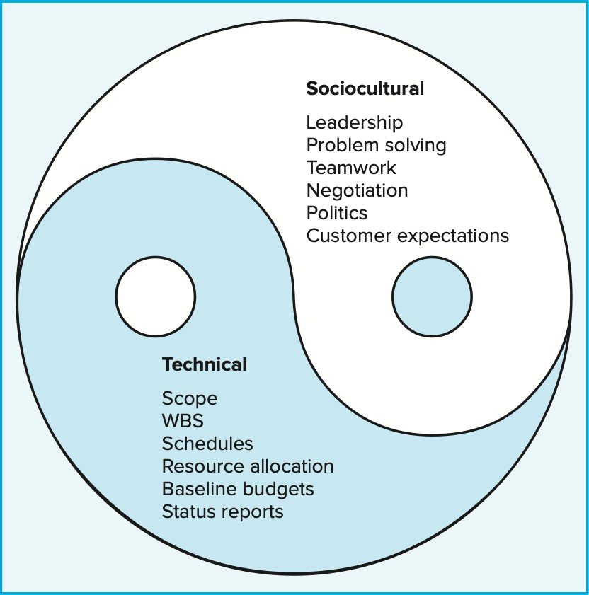
Project Management Today: A Socio-Technical Approach
Managing a project is a multidimensional process:
Technical side “science”: planning, scheduling, and controlling projects.
Sociocultural side “art”: creating a temporary social system within a larger organizational environment
that combines the talents of a divergent set of
professionals working to complete the project, managing the interface between the project and external environment (customer, top management,
…..)

Slide 30
Examples of Projects
Systems Enoineer: develop data mining software for medical papers and studies related to medicine effectiveness.
Industrial Enoineer: create a value chain report for every
aspect of a product from design to customer delivery.
Electrical Enqineer: create a web-based user manual for
a new electronics product.
Computer Enqineer: install new data security system for
a business information system.

Slide 31
Exercise
Check out the Project Management Institute’s home page at
www.pmi.org
Review general information about PMI as well as membership information. Accordingly, state how to be amember in PMI.
See if there is a PMI chapter in your country. If not, where is the closest one?
State the different Certificates from PMI.

Slide 32
Assignments “Important Points to consider”
Solve the assignments week by week to get the full benefit in the tutorial.
Each team will solve each assignment together (starting from lecture 4 assignment).
Discussion with the TA each week to shorten the project preparation duration before the deanline (you will be busy with the in-class tests).
Search the internet seriously.
Numbers and its relation to practical life are very important.
Do not expect to respond immediately in weired timings !!!

Slide 33
Commonly Used Program and Project Management Tools
The best tool for your team depends on your specific needs, project complexity, and team size. Look at this list of tools and services that are commonly used by project and program managers and see if some of them might be useful for you:
TelescopeAI: Offers data-driven insights to optimize product development and performance.
Jira: Used by agile teams and famous for its bug-tracking system.
Monday.com: Offers flexible planning and monitoring capabilities.
Wrike: Helps manage projects, organize tasks, and collaborate.
Asana: Known for its user-friendly interface and collaboration features, it is a popular choice for teams of all sizes.
Trello: Ideal for smaller teams and projects that require a Kanban-style workflow.
Smartsheet: Provides a spreadsheet-like interface for managing projects, tasks, and workflows.
ClickUp: A versatile tool with many features, including task management, project management, and document collaboration.
Microsoft Project: A classic project management tool with Gantt charts and resource allocation capabilities.

